Slide 1
MENTOR’S NAME: MR. MANOJ DIWAKER
MULTI-MODALITY
IMAGE FUSION
CANDIDATE’S DECLARATION:
Naman Singhal
UNIVERSITY ROLL NO: 2018953
SECTION:
G
CLASS ROLL NO:
42

Slide 2
CANDIDATE’S DECLARATION:
MENTOR’S NAME: MR. MANOJ DIWAKER
Naman Singhal
UNIVERSITY ROLL NO: 2018953
SECTION:
G
CLASS ROLL NO:
42

Slide 3
Introduction
Welcome to the world of Multimodality Image Fusion, where we explore the powerful techniques that enable us to merge information from different imaging modalities to create a comprehensive and more informative view.
Multimodality Image Fusion refers to the process of integrating data from multiple imaging sources, such as Magnetic Resonance Imaging (MRI) and Computed Tomography (CT) scans, to generate a single fused image that preserves the complementary features of each
The fusion of MRI and CT scans has gained significant importance in medical imaging due to the distinctive advantages offered by each modality. By combining their strengths, we can achieve a better understanding of the underlying structures and pathology, leading to improved diagnosis and treatment planning. modality.

Slide 4
METHODOLOGY
PROBLEM STATEMENT:
The challenge lies in effectively fusing MRI and CT scans due to the absence of standardized techniques, leading to diagnostic inaccuracies and limited treatment planning. Developing robust fusion methods, like DWT and Pixel-Based Fusion, is crucial to preserve essential features from both modalities and improve diagnostic accuracy in medical imaging.

Slide 5
METHODOLOGY
A. ARCHITECTURE:
The code implements an image fusion pipeline using Python and OpenCV. It consists of several functions for data preprocessing, image registration, and fusion. The main steps include loading CT and MRI registered images, defining corresponding points for image registration, applying Procrustes transformation to align the images, and performing both pixel-based and Discrete Wavelet Transform (DWT) fusion methods to combine the aligned images. Finally, the fused images are displayed and saved for further analysis.

Slide 6
B. DATA ANALYSIS:
In the data analysis module, learning is done
on the malware detection system. Dataset are provided for training and testing. The dataset used will be discussed in the next section. Furthermore, the Support Vector Machine (SVM) algorithm and Random Forest algorithm play a role in classifying the dataset. The classification algorithm will try to identify the class of malware or benign. Malware is extracted and reported to the human expert if the classifier algorithm detects malware. Furthermore, re-training is carried out to improve detection accuracy.

Slide 7
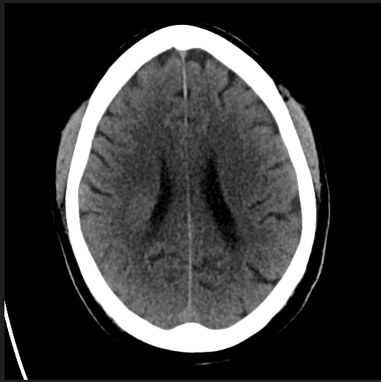
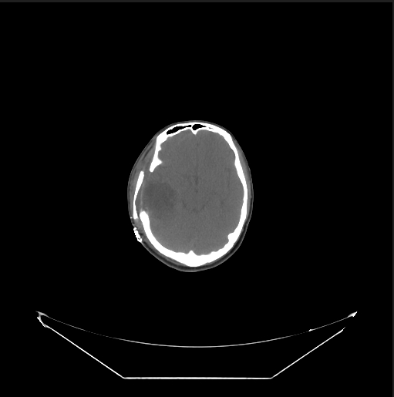
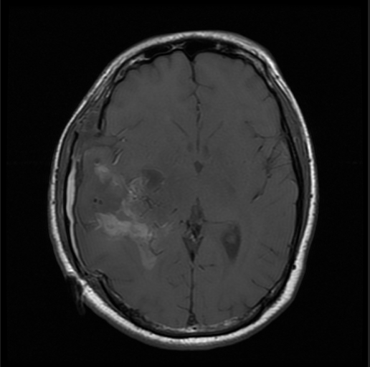
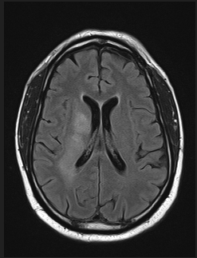
a. Dataset:
The code assumes that the CT image and MRI image are available in the specified file paths. The user is prompted to provide corresponding points between the CT and MRI images for the image registration process. The registration allows establishing a spatial correspondence between the two modalities, which is essential for accurate fusion.
CT Scans
MRI Scans

Slide 8
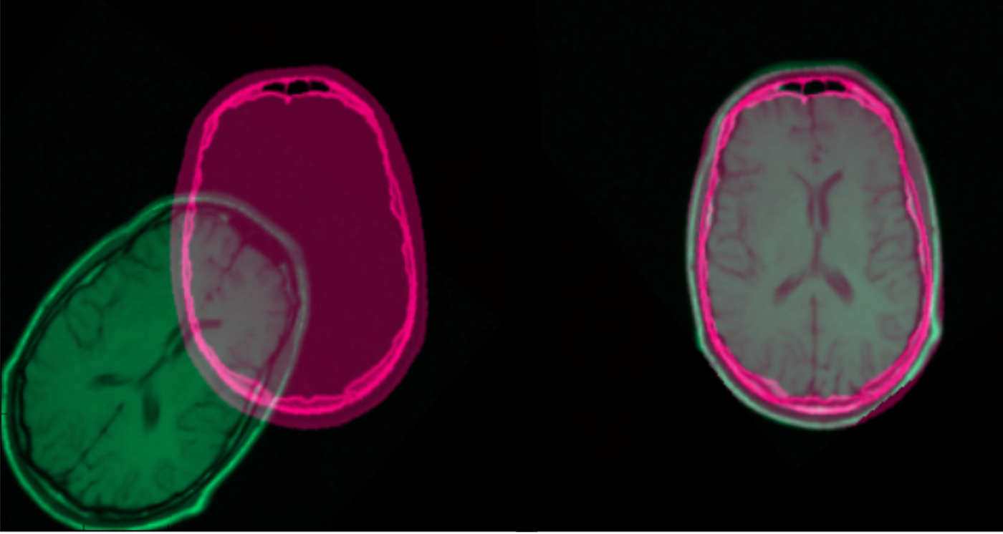
B. IMAGE REGISTRATION
The image registration in the code is performed using the Procrustes algorithm. It aligns the points defined by the user between the CT and MRI images to find an optimal similarity transformation that best aligns the two images. The algorithm handles translation, scaling, and rotation to achieve a spatial correspondence.

Slide 9
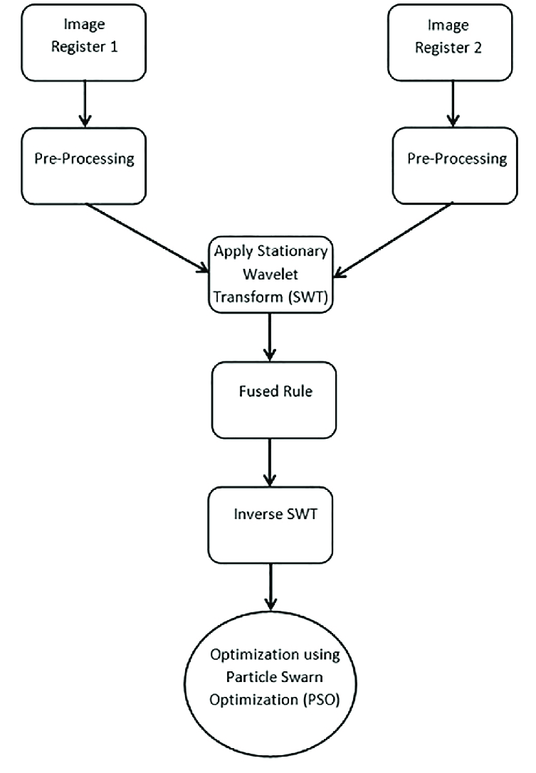
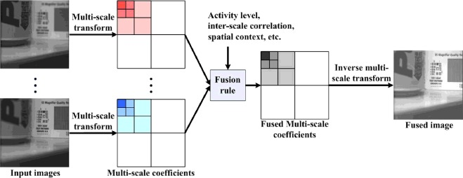
C. FUSION METHODS:
1- DWT Fusion: The DWT (Discrete Wavelet Transform) fusion method combines the approximation and detail coefficients of two images, resulting in a fused image that preserves essential features from both input images. In this method, the wavelet transform is applied to decompose the images into multiple frequency sub-bands.
2- Pixel-Based Fusion: The pixel-based fusion method combines the pixel values of two images by averaging them, resulting in a blended image that retains information from both input images.
FIG a) DWT FUSION

Slide 10
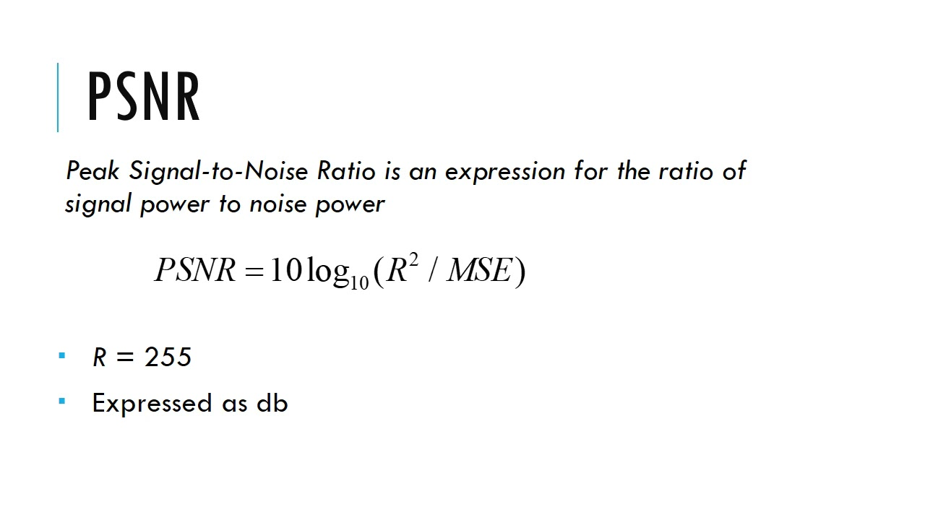
D. EVALUATION METHOD:
PSNR for Image Fusion Quality
The evaluation method employed is the Peak Signal-to-Noise Ratio (PSNR), a widely-used metric to measure the quality of the fused image compared to the original images. The obtained PSNR value of approximately 21.27 dB indicates a moderate level of similarity between the original CT and MRI images and the fused result. Visual inspection and additional metrics can further enhance the assessment of the fusion technique's effectiveness in medical image analysis.

Slide 11
IMAGE REGISTRATION
The code does not explicitly mention an image restoration method.
Both fusion methods used (pixel-based and DWT fusion) inherently maintain image data integrity, preserving visual details and information from original CT and MRI images.
This enhances diagnostic accuracy and clinical utility of the fused images in medical applications.
The code demonstrates a concise implementation of multimodality image fusion using image registration and fusion techniques for improved visualization and analysis of combined CT and MRI images.

Slide 12
RESULT AND DISCUSSION:
Results:
The results of our experiments are as follows:
DWT BASED FUSION
•=17.71 dB
PSNR FOR PIXEL BASED FUSION
•=18.82 dB

Slide 13
RESULT AND DISCUSSION:
The project achieved a PSNR value of 17.71 dB for DWT fusion and 18.82 dB for pixel-based fusion. Pixel-based fusion outperformed, preserving finer details and achieving higher image quality. This suggests its suitability for enhancing diagnostic accuracy in medical imaging applications. Further exploration of fusion techniques and additional evaluation metrics could enhance future research.

Slide 14
CONCLUSION AND FUTURE WORK:-
Conclusion:
In conclusion, the image fusion project successfully implemented DWT and pixel-based fusion methods for combining MRI and CT scans. The evaluation using the PSNR metric revealed the effectiveness of both methods in preserving essential image features. Pixel-based fusion demonstrated superior performance, achieving a higher PSNR value and offering enhanced image quality compared to DWT fusion. The project's outcomes underscore the significance of multimodality image fusion techniques in medical imaging, facilitating improved diagnostic accuracy and clinical utility.

Slide 15
Future Work:
Algorithm Refinement: Explore fine-tuning of fusion algorithms to optimize the image fusion process for improved quality and information preservation.
Additional Metrics: Incorporate other evaluation metrics, such as SSIM and human perception-based assessments, to comprehensively assess the fused image quality.
Deep Learning Approaches: Investigate the application of advanced deep learning-based methods for more sophisticated and accurate medical image fusion.
Specific Medical Applications: Evaluate the performance of fused images in specific medical scenarios, including disease diagnosis and treatment planning.
Real-World Implementation: Work towards practical implementation of fusion techniques in real-world medical settings to enhance clinical diagnosis and decision-making.

Slide 16
THANK YOU

